Slide 2
Objectives - Project Outline
HSE Project 2550 LOT4
Information Architecture of the
National Integrated Services Framework (ISF)

Slide 3
Agenda
Executive Summary
  Introduction: the challenge
  Tenders Lots 1- 6
  LOT 4 - General Introduction
  Reason, Requirements, Workshops, Questionnaire
  LOT 4 Part 1 - INFORMATION MODEL REQUIREMENTS
  LOT 4 Part 2 - DATA DICTIONARY REQUIREMENTS
  LOT 4 Part 3 - TERMINOLOGY ASSURANCE REQUIREMENTS
  LOT 4 Part 4 - SUPPORT PROCESSES & SERVICES
Q&A session
(Validation, suggestions for improvements)

Slide 4
Agenda
Executive Summary
  Introduction: the challenge
  Tenders Lots 1- 6
  LOT 4 - General Introduction
  Reason, Requirements, Workshops, Questionnaire
  LOT 4 Part 1 - INFORMATION MODEL REQUIREMENTS
  LOT 4 Part 2 - DATA DICTIONARY REQUIREMENTS
  LOT 4 Part 3 - TERMINOLOGY ASSURANCE REQUIREMENTS
  LOT 4 Part 4 - SUPPORT PROCESSES & SERVICES
Q&A session
(Validation, suggestions for improvements)

Slide 5
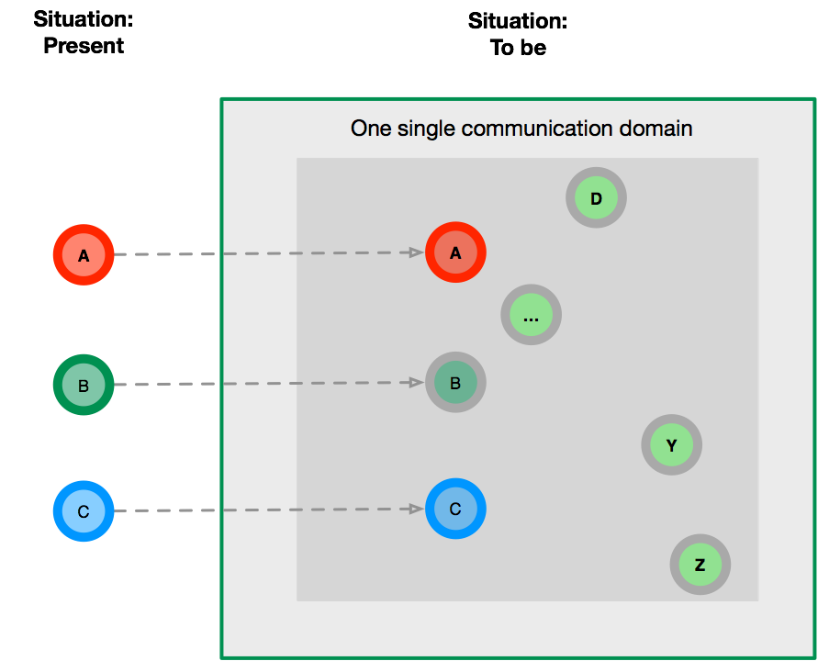
Project
Introduction
Why

Slide 6
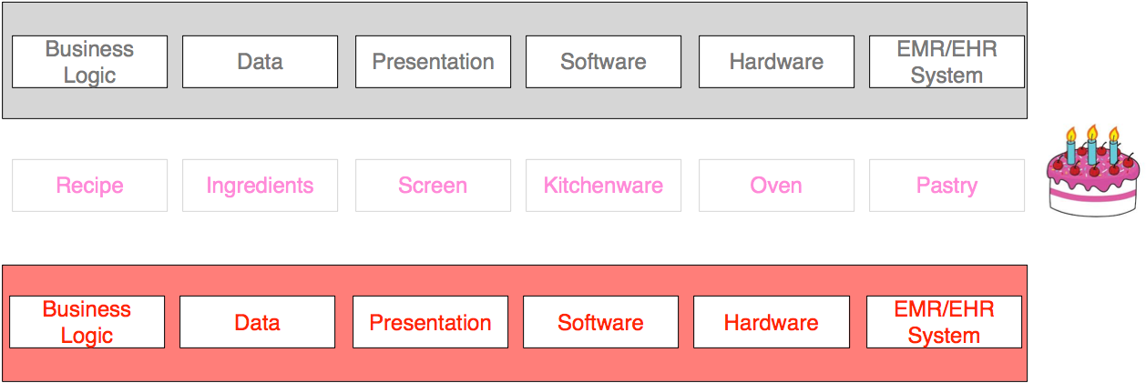
Project
Introduction
EHR-systems
Silo’s

Slide 7

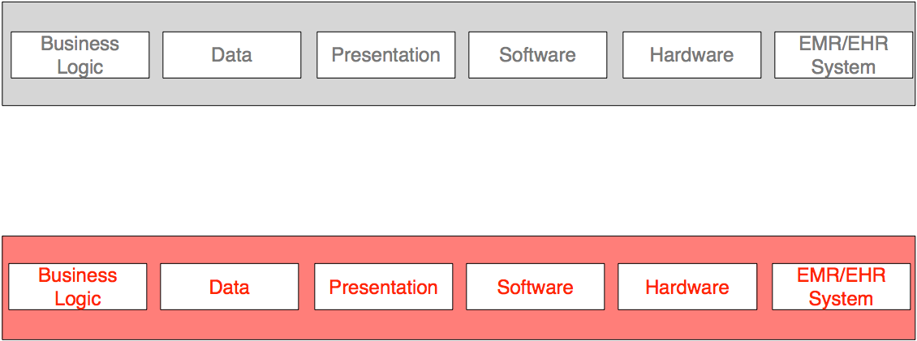
Project
Introduction
EHR-systems
Minimal condition:
Share normalised data

Slide 8
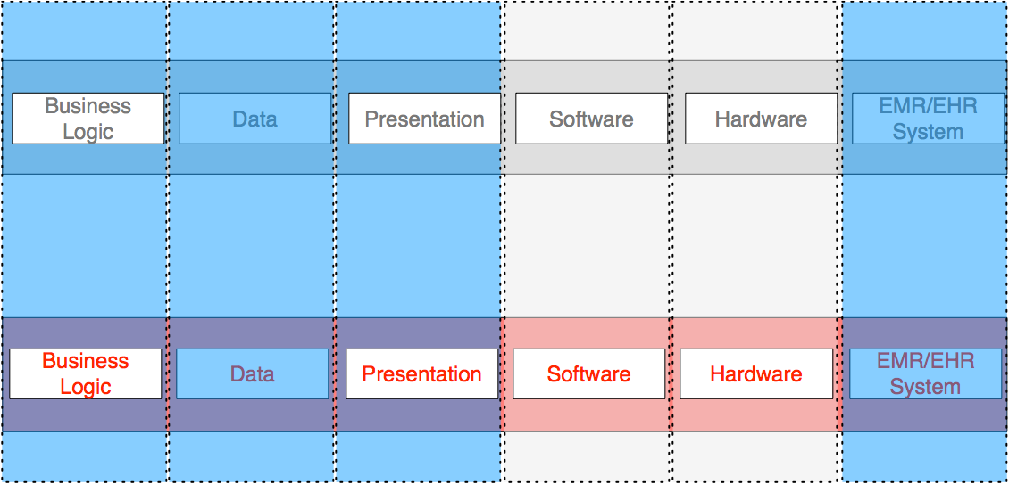
Project
Introduction
EHR-systems
Maximal condition
Share: Normalised data, logic and presentation

Slide 9
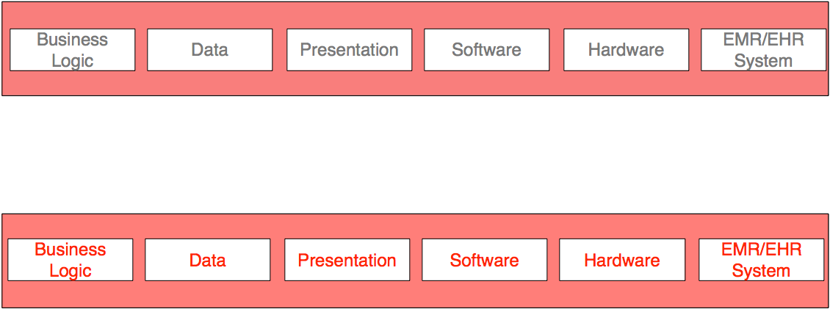
Project
Introduction
EHR-systems
One big system

Slide 10
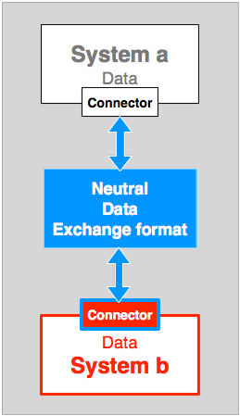
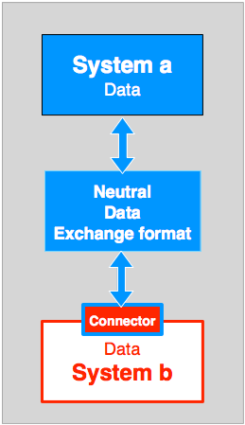
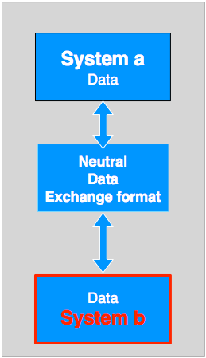
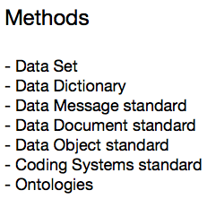
Project
Introduction
viable Ecosystem
Methods for sharing data
Data Exchange standard

Slide 11

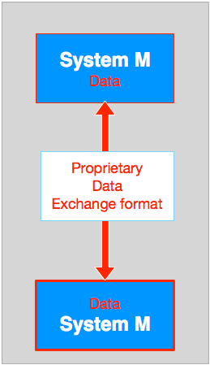
Project
Introduction
viable Ecosystem
Methods for sharing data
Evolution - Revolution

Slide 12
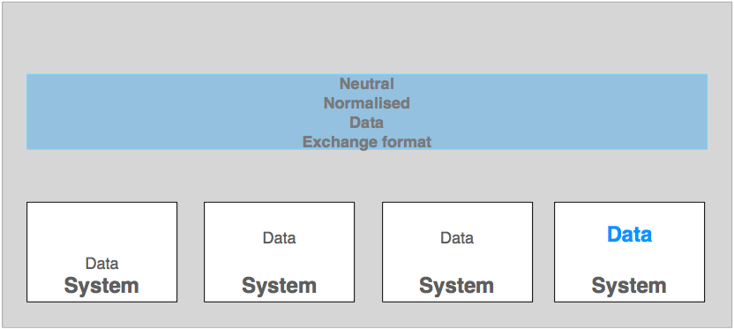



Project
Introduction
Connector Deployment

Slide 13



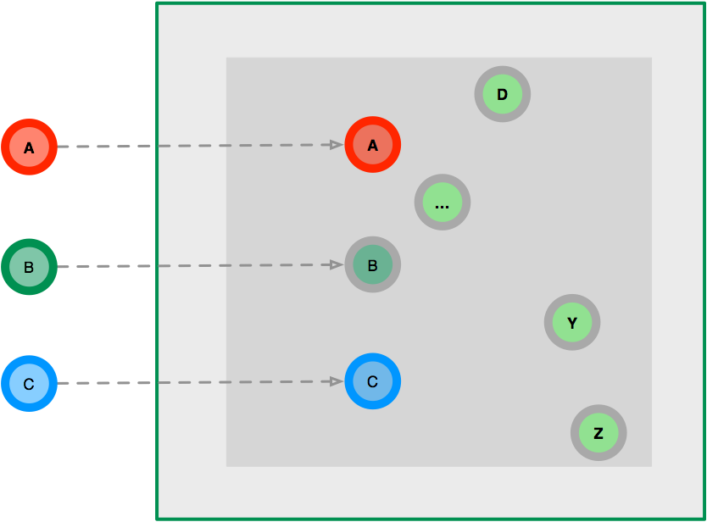








Project
Introduction
Large scale deployment

Slide 14
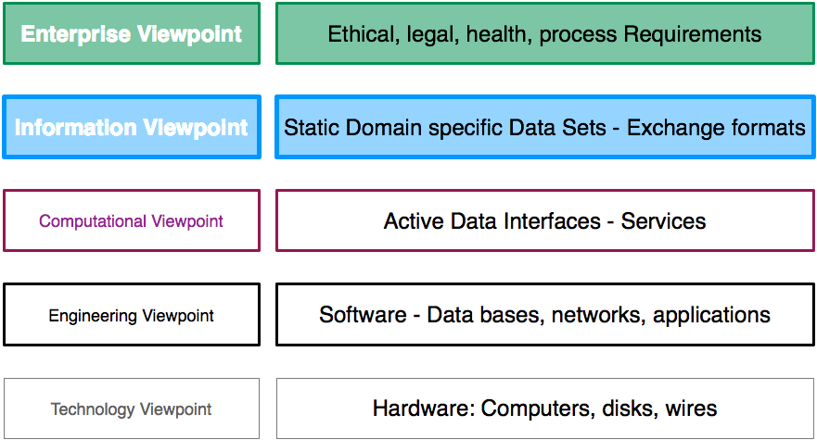
Project
Introduction
Scope of this project
RM-ODP: Information Viewpoint

Slide 15
Agenda
Executive Summary
  Introduction: the challenge
  Tenders Lots 1- 6
  LOT 4 - General Introduction
  Reason, Requirements, Workshops, Questionnaire
  LOT 4 Part 1 - INFORMATION MODEL REQUIREMENTS
  LOT 4 Part 2 - DATA DICTIONARY REQUIREMENTS
  LOT 4 Part 3 - TERMINOLOGY ASSURANCE REQUIREMENTS
  LOT 4 Part 4 - SUPPORT PROCESSES & SERVICES
Q&A session
(Validation, suggestions for improvements)

Slide 16
Information Service Framework
Mini - Tenders
ISF six LOTs
  Lot 1 - EHR Integrated Services
  Lot 2 - Technical Infrastructure
  Lot 3 - High Level Business Process
  Lot 4 - Information Architecture
  Lot 5 - Access
  Lot 6 - Governance

Slide 17
Agenda
Executive Summary
  Introduction: the challenge
  Tenders Lots 1- 6
  LOT 4 - General Introduction
  Reason, Requirements, Workshops, Questionnaire
  LOT 4 Part 1 - INFORMATION MODEL REQUIREMENTS
  LOT 4 Part 2 - DATA DICTIONARY REQUIREMENTS
  LOT 4 Part 3 - TERMINOLOGY ASSURANCE REQUIREMENTS
  LOT 4 Part 4 - SUPPORT PROCESSES & SERVICES
Q&A session
(Validation, suggestions for improvements)

Slide 18
LOT 4 - General Introduction
Reasons
  Ireland: Need for a sharable EHR and
  harmoninous delivery of Universal Health Insurance
  European developments
    European Directive on the application of patients’ rights in cross-border healthcare
    Guidelines on minimum and non-exhaustive patient summary
    for electronic exchange in accordance with
    the Directive 2011/24/EU release 1
    epSOS Cross border exchange of Patient Summary, ePrescription
    Ireland is establishing a National Contact Point for epSOS

Slide 19
LOT 4 - General Introduction
Requirements
  Cost effective
  NO revolution
  Stepwise evolution
  Respect investments in working solutions (e.g. HisLink)
  Exchange data with HSE in a normalised format
  Impose data requirements via HSE procurement

Slide 20
LOT 4 - General Introduction
  Part 1 - Information Architecture Reference Model
    IA-RM
    SAM’s
    Recommendations
    Catalogue of standards
  Part 2 - Data Dictionary
    SDD
    Validation (POC)
    Recommendations
    Catalogue of standards

Slide 21
LOT 4 - General Introduction
  Part 3 - Terminology Assurance
    Blue print for deployment, management and maintenance
    Binding os SNOMED to c;inial data set
    Catalogue of standards
  Part 4 - Support Process & Services
    Standards based tool sets, support structure
    Comparison of products
    Recomendations for Toolset and mangement

Slide 22
LOT 4 part 1
1- Information Architecture Reference Model
2- Data Dictionary
3- Terminology Assurance
4- Support Processes & Services

Slide 23
LOT 4 part 1
Information Architecture Reference Model
Data Dictionary
Terminology Assurance
Support Processes & Services

Slide 24
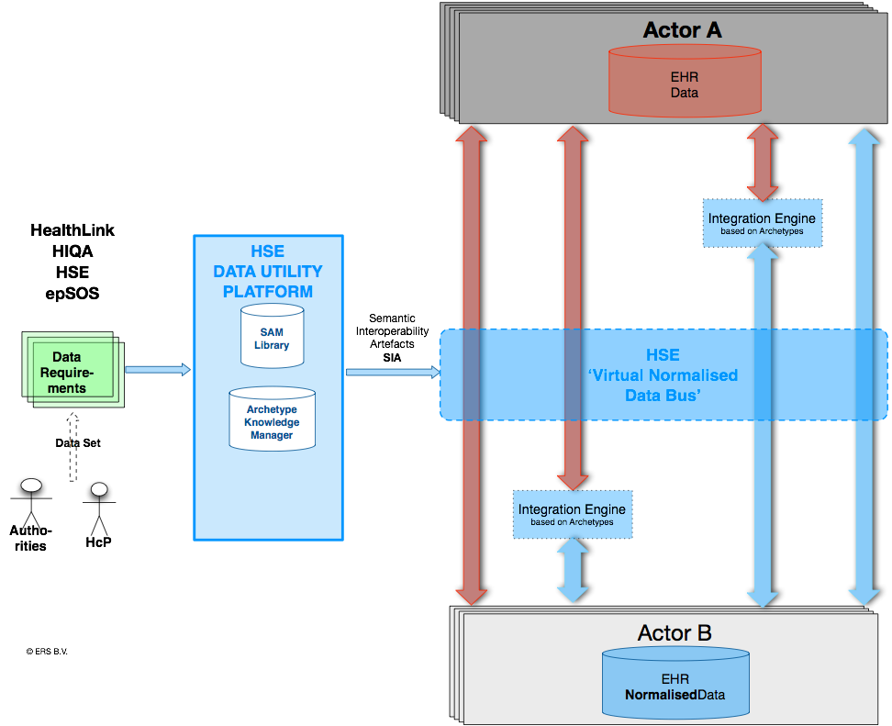
Information Architecture
Reference Model
Findings

Slide 25
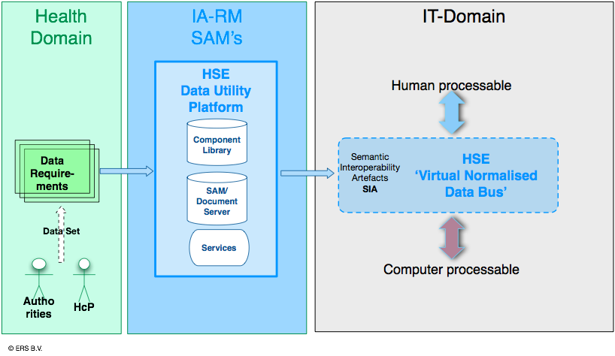
Information Architecture
Reference Model
Findings

Slide 26
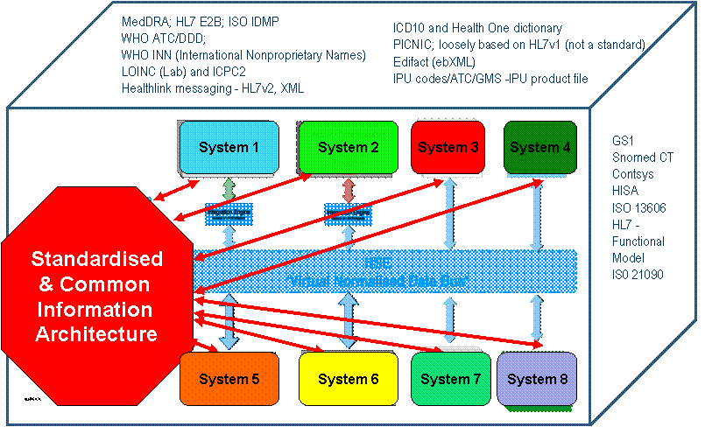
Information Architecture
Reference Model
Findings

Slide 27
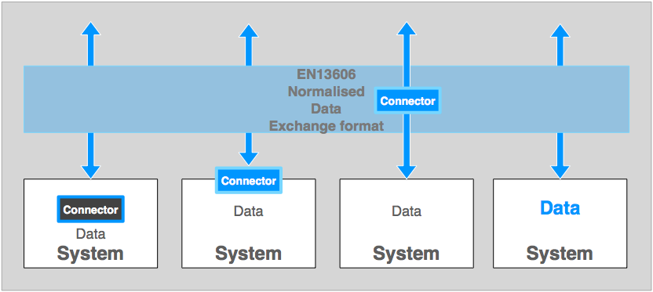
Information Architecture
Reference Model
Findings

Slide 28
Information Architecture
Reference Model
Findings
Decision tree
    Open International standards
    Scope: Create SAM’s that serve the RM/ODP Information Viewpoint only
    Standards that are in use
    Supports existing message, document solutions and ‘EHR’ persistence

Slide 29
Decision tree
 | Open Standards | Scope RM/ODP Information Viewpoint Create a library of re-usable components | Standards in use according to the scope | Support existing solutions and EHR persistence
HL7 V2 | + | - | - | -
HL7 v3 | + | - | - | -
HL7 v3 CDA | + | - | - | -
FHIR | - | - | - | -
OpenEHR | - | + | + | +
CEN/ISO13606 | + | + | + | +
More than RM/ Viewpoint
Not used for SAM’s
No EHR spec.
More than RM/ Viewpoint
Not used for SAM’s
No EHR spec.
More than RM/ Viewpoint
Not used for SAM’s
No EHR spec.
No public open standard
No public open standard

Slide 30
[Show Template - Archetype]
[Show some outputs]

Slide 31
Information Architecture
Reference Model
Recommendations
  Decide to base the IA-RM on the CEN/ISO 13606 standard.
  Accept the proposed IA-RM as basis for the production, maintenance and governance of Subject Area Models.
  Decide to acquire (access to) a CEN/ISO En13606 conformant Archetype (and Template) editor.
  Decide to use the defined Subject Area Models in procurement processes for health IT-systems.
  Decide to use Subject Area Models as the description of existing HL7v2 and HL7v3 CDA payloads.
  Decide to add to procurement processes a Connector based on CEN/ISO EN13606 to integrate more efficiently IT-systems with the HSE ISF Data Utility Platform and each other.
  Decide to acquire a mapping Connector or acquire access to a service.

Slide 32
Information Architecture
Reference Model
Recommendations
  Produce SAM’s (as CEN/ISO13606 Templates) expressing data needs by the healthcare providers and agencies, using an Archetype Library with re-usable components.
  Generate output formats that present the SAM’s for inspection and validation by humans and processing by IT-vendors.
  Adopt available CEN/ISO standards for quality systems, testing/certification, requirements for EHR-system architectures, etc.
  (A list is provided in the main document)
  Appoint/create an organisation responsible for the governance of HSE ISF HSE Tooling Utilities Platform and its output and organisation work processes.

Slide 33
Executive Summary
  Introductin
  Tender Lots 1- 6
  General Introduction
  Requirements, Workshops, Questionnaire
  LOT 4 Part 1 - INFORMATION MODEL REQUIREMENTS
  LOT 4 Part 2 - DATA DICTIONARY REQUIREMENTS
  LOT 4 Part 3 - TERMINOLOGY ASSURANCE REQUIREMENTS
  LOT 4 Part 4 - SUPPORT PROCESSES & SERVICES
Q&A session
(Validation, suggestions for improvements)

Slide 34
Data Dictionary
Findings
Standard Based Data Dictionary
Validation (PoC) of Data Dictionary
Governance Framework and Tooling
Catalogue of Standards

Slide 35
Data Dictionary
Findings
ERS has
  conducted workshops and a questionnaire
  made available and demonstrated an ISO 11179 conformant static Data Dictionary using the epSOS data set
  compared with the functionality of CEN/ISO EN13606 artefacts/outputs
  concluded that CEN/ISO EN13606 artefacts/outputs provide more details needed in deployment. Better alignment with data sets.
  made the observation thatSpain (Minstry of Health), NHS -HSCIC, CIMI made the same choice
  concluded that next to the Archetype Editor for the production of SAM’s a Document Management Service is needed for governance

Slide 36
Data Dictionary
Recommendations
  Instead of a Data Dictionary deploy CEN/ISO EN13606 Templates and Archetypes as more descriptive and usable alternative.
  Use a Document Management service as part of the HSE Tooling Utility Platform to manage all SAM’s and constituting standardised components.
  Decide to use the epSOS data set as first filling of the collection of Subject Area Models (templates and archetypes) the HSE Tooling Utility Platform.
  Decide to select and use a standards based Document Management System to manage all documents, files that constitute SAM’s and its building blocks.
  Decide to actively use, deploy, maintain the list of relevant standards that support the HSE ISF HSE Tooling Utility Platform.

